Slide 1
Pipirima: Predicting Patterns in Sparsity to Accelerate Matrix Algebra
Ubaid Bakhtiar, Donghyeon Joo, Bahar Asgari
{ubaidb,dhjoo98,bahar}@umd.edu
University of Maryland
Computer Architecture & Systems Lab

Slide 2
INTRODUCTION

Slide 3
Sparsity
The existence of zeros in a matrix is referred to as “sparsity “
Sparsity exist across different domains. For example:
LARGE LANGUAGE MODELS
SCIENTIFIC COMPUTING
GENOMICS
RECOMMENDATION SYSTEMS
Notes:
Over the years, sparse matrices have become crucial in various fields such as scientific computing, computer vision, transformers and recommendation systems.
sparsity offers opportunities to eliminate unnecessary computations, storage, and data movement. For example, a bigger sparse matrix is compressed into several small matrices to save storage, data movement, and computations

Slide 4
Sparse Kernels
Kernels with at least one sparse operand are termed as sparse kernels. For example:
Sparse matrix-dense matrix multiplication (SpMM)
Sparse matrix-dense vector multiplication (SpMV)
Sparse matrix-sparse matrix multiplication (SpGEMM)
1 | 2 | 0 | 3
4 | 0 | 0 | 5
6 | 0 | 0 | 0
7 | 8 | 9 | 0
1 | 1 | 1 | 1
2 | 2 | 2 | 2
3 | 3 | 3 | 3
4 | 4 | 4 | 4
1 | 2 | 0 | 3
4 | 0 | 0 | 5
6 | 0 | 0 | 0
7 | 8 | 9 | 0
1 | 2 | 0 | 3
4 | 0 | 0 | 5
6 | 0 | 0 | 0
7 | 8 | 9 | 0
1 | 2 | 0 | 3
4 | 0 | 0 | 5
6 | 0 | 0 | 0
7 | 8 | 9 | 0
1 | 2 | 3 | 4
Dense B
Sparse A
Dense B
Sparse A
Sparse A
Sparse B

Slide 5
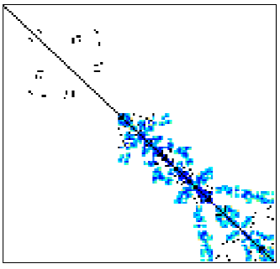
Leveraging Sparsity
Enables matrix compression
Reduces the storage requirement
Speeds up the computations
Mitigates data movement overhead
An example sparse matrix – Density < 0.1%

Slide 6
Sparse Matrix Compression
Main Goal: Discard the zeros and only store the non-zeros along with relevant meta-data
Compressed Sparse Row (CSR):
Example sparse matrix
1 | 2 | 0 | 3
4 | 0 | 0 | 5
6 | 0 | 0 | 0
7 | 8 | 9 | 0
Offsets:[0, 3, 5, 6, 9]
Indices:[0, 1, 3, 0, 3, 0, 0, 1, 2]
Values: [1, 2, 3, 4, 5, 6, 7, 8, 9]
Notes:
Common Compression Formats:
Coordinate List (COO)
ELLPACK (ELL)
Block Sparse Row (BSR)
Compressed Sparse Column (CSC)
Compressed Sparse Row (CSR)

Slide 7
CHALLENGES

Slide 8
Existing Sparse Kernel Accelerators
State-of-the-art sparse accelerators:
ExTensor (Hedge et al. MICRO 2019). Proposes a hierarchical elimination of computation to avoid unnecessary data transfers
Tensaurus (Srivastva et al. HPCA-2020). Employs a novel format for accessing sparse data to optimize memory bandwidth using tiles
Drawback
SOTA accelerators do not leverage the patterns of sparsity in a sparse matrix and consequently results in fine-grained load imbalance
Notes:
Existing sparse kernel accelerators offer methods ranging from new microarchitectural supports for sparsity to enhancing memory bandwidth utilization.
Extensor: Proposes a hierarchical elimination of computation in sparse environments by identifying multiplication cases where both operands are non-zero, thus avoiding unnecessary data transfers Tensaurus: Employs a novel format for accessing sparse data in a vectorized and streaming manner, optimizing memory bandwidth usage by splitting dense vectors into tiles.
In addition to kernel-specific accelerators, domain-specific accelerators are also proposed that deals with sparse data such as scientific computing and machine learning.
However, there are evident drawbacks in these accelerators…..

Slide 9
Fine-grained Load Imbalance: No Distribution
Distribution of non-zero values across on-chip memory is important to ensure minimal load imbalance
 | 0 | 1 | 2 | 3 | 4 | 5 | 6 | 7
r0 |  | a |  | b | c
r1
r2 |  |  |  |  | d | e | f
r3 |  | g | h |  |  | i
r4
r5 |  |  |  | j | k |  | l
r6
r7 | m |  | n |  |  | o
Cycles:
1 | 2 | 3 | 4 | 5 | 6 | 7 | 8 …
Read r0 | Comp r0
R r2 | C r2
Partition 1
o | … | c | b | a
R r3
Serial Placement of non-zero values results in bottlenecks
Notes:
Here, we assume that we have a streaming accelerator including a pipeline buffer. To process a sparse matrix such as the one shown in Figure 2, for each row, we need to first read the NNZ elements from the on-chip buffer and then perform the computation of that row where R rx and C rx are pipelined.
Given such a pipeline there are three cases. The first is: having only one partition of on-chip memory, which serializes reading the NNZ values. This is inefficient and does not offer any kind of parallelism

Slide 10
Fine-grained Load Imbalance: Imperfect Distribution
Distribution of non-zero values across on-chip memory is important to ensure minimal load imbalance
 | 0 | 1 | 2 | 3 | 4 | 5 | 6 | 7
r0 |  | a |  | b | c
r1
r2 |  |  |  |  | d | e | f
r3 |  | g | h |  |  | i
r4
r5 |  |  |  | j | k |  | l
r6
r7 | m |  | n |  |  | o
Cycles:
1 | 2 | 3 | 4 | 5 | 6 | 7 | 8 …
Read r0 | Comp r0
Read r2 | Comp r2
Partition 1
o | … | e | c | a
Read r3 | Comp r3
Partition 2
n | … | f | d | b
Read r5
Sub-par parallelism due to non-zero distribution among two memory partitions
Notes:
The second is: having more than one partition of on-chip memory but an imperfect distribution of NNZ values, which reduces the R rx time but does not completely solve the problem

Slide 11
Fine-grained Load Imbalance: Perfect Distribution
Distribution of non-zero values across on-chip memory is important to ensure minimal load imbalance
 | 0 | 1 | 2 | 3 | 4 | 5 | 6 | 7
r0 |  | a |  | b | c
r1
r2 |  |  |  |  | d | e | f
r3 |  | g | h |  |  | i
r4
r5 |  |  |  | j | k |  | l
r6
r7 | m |  | n |  |  | o
Cycles:
1 | 2 | 3 | 4 | 5 | 6
R r0 | C r0
R r2 | C r2
Partition 1
m | … | g | d | a
R r3 | C r3
Partition 2
o | … | h | e | b
R r5 | C r5
Partition 3
n | … | i | f | c
R r7 | C r7
Maximum parallelism due to perfect non-zero distribution
Notes:
The third is: A perfect distribution of NNZ values to as many partitions as they need, which minimizes the R rx and results in a more balanced pipeline.

Slide 12
Decompression Overhead
Decompressing a sparse matrix involves finding out the correct location of non-zero values in a larger matrix.
Input: Compressed Matrix (CSR)
Decode metadata → (offset, index)
2. Locate non-zeros → (row, col)
3. Compute → Output[i][j] = f(Value, i, j)

Slide 13
OBSERVATIONS

Slide 14
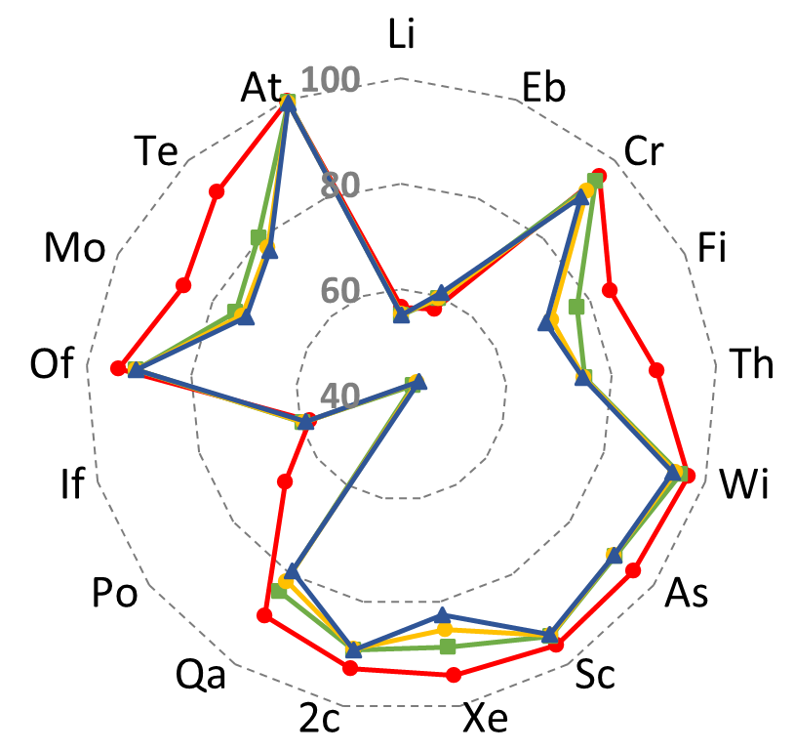
Structural Coherence
Observation 1. There is structural coherence among rows of a sparse matrix.
Key Observation
On average 78-85% of the rows are homogeneous to their last u neighbors in terms of NNZ* values.
Row homogeneity % for the last “u” neighbors of SuiteSparse workloads
*NNZ: Number of non-zeros
Notes:
Here in this graph, we ran experiments on suitesparse matrices. The goal was to find out what %age of rows in a matrix mimic their last neighbours in terms of non-zero values. We also observed that the resemblance is most pronounced when u=1.

Slide 15
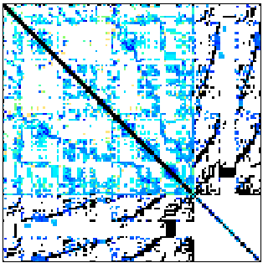
Diagonal Matrices
Observation 2. Some sparse matrices exhibit strictly diagonal pattern.
Strictly Diagonal
Highly Random
Key Observation
The non-zeros location in a strictly diagonal matrix is pre-determined and we can skip decompressing them
bcsstkm21
scircuit
SuiteSparse Workloads

Slide 16
ARCHITECTURE

Slide 17
Key Insight
To enable fine-grained load imbalance, Pipirima predicts the NNZ values for the current block based on history of the previous blocks (like branch predictors in CPUs).
Using such a simple predictor, by just reading a single counter, Pipirima distribute them evenly as values and indices are streamed.
Notes:
To enable fine-grained load imbalance, Pipirima predicts the NNZ values for the current block based on history of the previous blocks. The predictions are just like branch predictors where the outcome of a branch is predicted based on the direction of previous branch

Slide 18
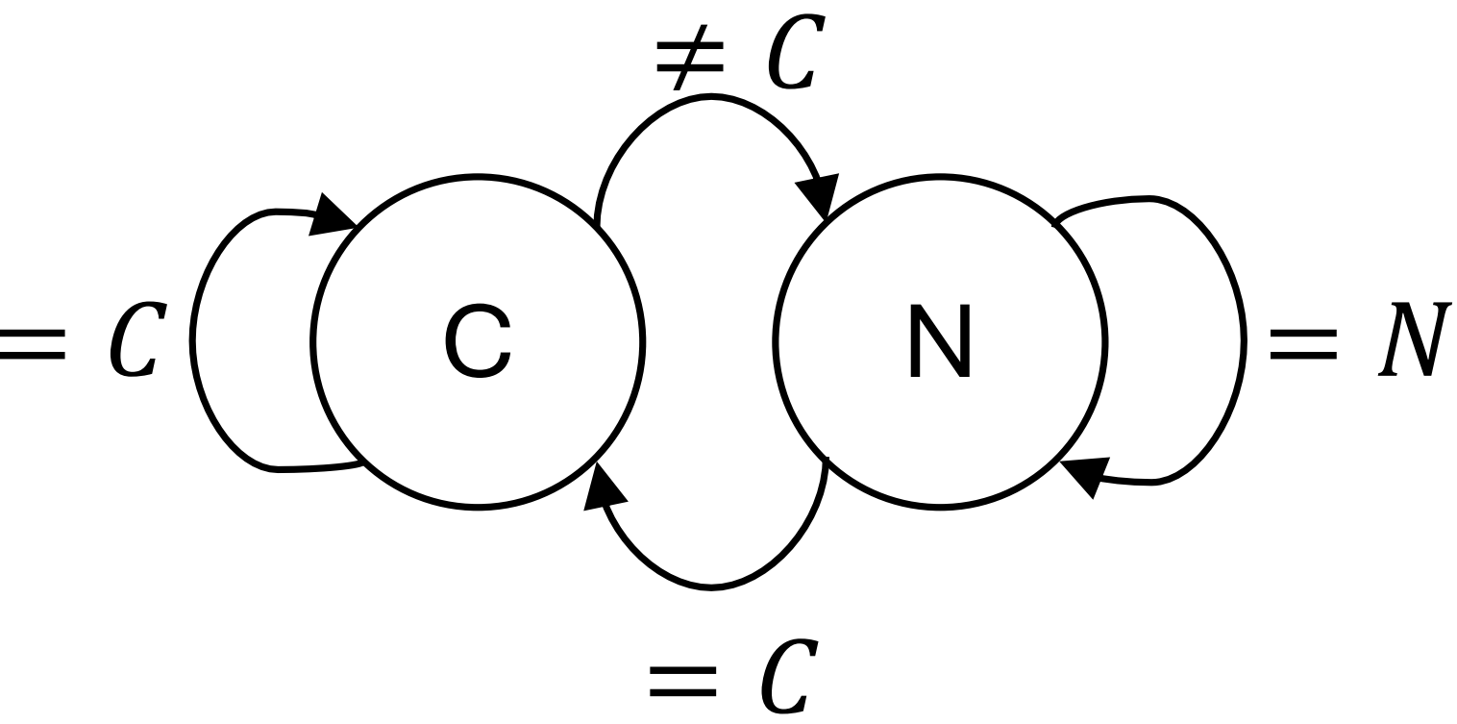
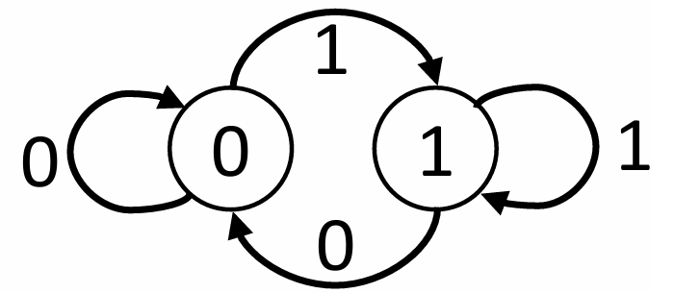
Prediction Mechanism
Pipirima uses Counter Based Predictors (CBP) to predict the structural properties of a given matrix
There are two type of predictors.
D/R Matrix Predictor
NNZ/row Predictor
It predicts if the sparse matrix has a random sparsity pattern or diagonal sparsity pattern.
State Diagram:
It predicts the number of non-zeros values per row. The decision is made based on the NNZ values in the subsequent row.
State Diagram:
1: Random Matrix 0: Diagonal Matrix
C: current NNZ/row
N: new NNZ/row
Notes:
D/R Matrix Predictor: Each possibility is represented by 1 state, stored in 1-bit register.
NNZ/row: Each possibility is represented by 1 state. For an nxm matrix, states are stored in ln(m)-bit register.
To keep the states of the predictor updated, we need to verify whether a prediction was correct or not and change the state accordingly if needed.
In a diagonal matrix the consecutive values in the column indices and row offset arrays have a difference of 1 and the size of these arrays is equal to n for an n × n matrix. Pipirima exploits these simple properties to inspect the predictions.
If prediction=1 (i.e., diagonal), it flushes the pipeline, resets the values sent to compute units, sets the state register to 0 (random), triggers the NNZ/row Predictor and gets the correct data from the memory for the Prediction Inspector
If prediction=0 (i.e., random), it flushes the pipeline, resets the values sent to the NNZ/row Predictor, sets the state register to 1 (diagonal), signals the memory controller, and sends values to the compute unit directly
NNZ/row Prediction Inspector
The mechanism of this inspector is simple, too, as the number of non-zeros for a row in a block can be calculated easily based on the offsets.
If the comparison is true, this signifies a correct prediction, hence no change in the state.
A misprediction by the the NNZ/row predictor does not cause any changes in the functionality as it only defines the load distribution.
Therefore, an NNZ/row misprediction only leads to a less than optimal performance and detecting such a misprediction only requires updating the state for the next predictions.

Slide 19
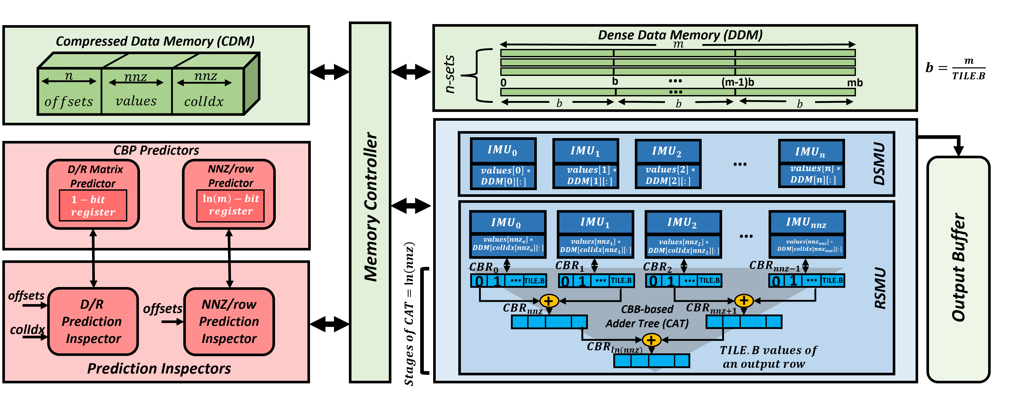
Architectural Components

Slide 20
Architectural Components
Notes:
Compressed Data memory
It is on-chip memory responsible for holding compressed sparse input data.
Upon receiving a command from the memory controller, it retrieves and dispatches the requested compressed data to the designated unit.
Dense Data Memory
It stores dense matrix or vector operand. It has n sets and m-size blocks to store an$n× m$ matrix tile.
Data is stored in row-major format to improve the spatial locality ensuring minimal memory misses.

Slide 21
Architectural Components

Slide 22
Computational Components
The basic computational unit is If-Mul Unit in Pipirima. Rest of the components are made up of the combinations of these.
If-Mul Unit
If-Mul Unit has a combination of a comparator and a multiplier.
It computes $TILE.B$number of multiplications in parallel.
It is compatible with both SpMV and SpMM operations.
22
Notes:
Dense matrix may have some zero values.
The comparator in If-Mul unit checks if it’s the case. In case of a zero (checked by the comparator), the multiplication is skipped else multiplier unit is triggered

Slide 23
Computational Components
If the D/R Matrix Predictor predicts the matrix to be diagonal, Pipirima triggers the DSMU unit.
Diagonally Sparse Multiplier Unit (DSMU)
In a diagonal matrix, there are only one non-zero per row.
DSMU does not need registers to hold the partial sums
The IMU in DSMU forwards the output directly to the output buffer
23

Slide 24
Computational Components
If the D/R Matrix Predictor predicts the matrix to be random, Pipirima triggers the DSMU unit.
Randomly Sparse Multiplier Unit (RSMU)
The number of non-zero values are already known to the compute unit by the virtue of NNZ/row Predictor
Based on the prediction, RSMU reads that number of non-zero values equal to the prediction and allocate each of them to an IMU.
24

Slide 25
Computational Components
If the D/R Matrix Predictor predicts the matrix to be diagonal, Pipirima triggers the RSMU unit.
Randomly Sparse Multiplier Unit (RSMU)
CBR-based Adder Tree (CAT):
IMUs are doing $TILE.B$number of multiplications in each step.
The partial outputs are pushed to corresponding Contiguous Block Registers (CBR)
The partial outputs are accumulated using an adder tree of $log⁡(nnz$) stages
25

Slide 26
Computational Components
Pipirima leverages the predictions and enhance the fine-grained parallelism
Advantage of predictions
Both DSMU and RSMU harness fine-grain parallelism by allowing each IMU to do $TILE.B$number of multiplication operations at a time.
Pipirima informed by the NNZ values per row (due to the prediction) can now employ multiple IMUs concurrently and does not have to segregate offsets load and values/indices load.
26

Slide 27
EVALUATION AND RESULTS

Slide 28
Experimental Setup
Workloads
Simulation Infrastructure
SuiteSparse Dataset
Synthetic Matrices
Transformer Workloads
Cycle-accurate simulator
RTL synthesis using Synopsys Design Compiler in TSMC 45nm Library
CACTI 7.0 for memory components
Baselines
ExTensor (dot-product-based SpMM)
Tensaurus (row-wise-product-base SpMM and SpMV)
Notes:
Workloads: SuiteSparse Matrices: We select a combination of random and diagonal matrices from SuiteSparse [6], with varying patterns of sparsity. The size of matrices range from 6M ×6M to 1k×1k. We break down, stream, and process these matrices into 512 × 512, 1024 × 1024, and 2048 × 2048partitions.
Synthetic Matrices: To analyze the behavior of Pipirima on highly dense matrices to more precisely investigate its impact on metrics such as misprediction, we also use synthetic random matrices of size 4096 × 4096 with varying density.
Transformer Workloads: To evaluate Pipirima for a wider range of applications, we use open source LLMs code to creates sparse matrices from the multi-head operations of transformer BERT trained on SQuAD v1.1. These matrices have a higher density (i.e., up to 32%) and are smaller than the SuiteSparse matrices

Slide 29
Evaluation
Prior knowledge of matrix partition structure allows Pipirima to distribute multiplications among IMUs.
Notes:
One of the main reasons for achieving performance improvements over baselines is the parallel computational operations corresponding to each non-zero value. The prior knowledge of matrix partition structure – diagonal or random and NNZ values per row, allows us to distribute the multiplication operations among different IMUs– key benefit of predictions.
Pipirima also uses tiling that helps to further parallelize multiplication operations within each IMU at the expense of extra multipliers. Tensuarus also uses tiling mech- anism to accelerate computations. This is the reason the speed up improvement over Tensaurus is not as much as ExTensor.

Slide 30
Evaluation
Pipirima gives promising speedup over dense transformer workloads as well.

Slide 31
Evaluation
Increasing density results in increased probability of different non-zero values per row and consequently, increased mispredictions
Synthetic Workloads
Notes:
With the increasing density, percentage mispredic- tions increase due to the increased probability of different NNZ values in consecutive rows and decreased row homo- geneity score.
The percentage misprediction increases with the increasing partition sizes too. This is due to the increased number of allowed states for the NNZ/row Predictor state register, making the system vulnerable to more mispre- dictions.

Slide 32
Evaluation
Overhead of prediction related components increases with increasing mispredictions
SuiteSparse Dataset
Memory Accesses Ratio
Operation Intensity Ratio
Misprediction %
Misprediction %
Misprediction %
Notes:
A ratio less than 1 signifies more overhead of prediction components, and greater than 1 signifies more overhead in traditional decompression.

Slide 33
Evaluation
Pipirima configuration and area
Pipirima takes$5.621 mm^{2}$area and consumes $544.93 mW$power
Prediction related components consume the least share of total area and power, that is,
$0.15\%$ of the total area
$0.54\%$of the total power

Slide 34
SUMMING IT UP….

Slide 35
Conclusions
Pipirima presents a novel approach to accelerate sparse matrix algebra, drawing inspiration from a simple local branch predictor
Predicts the structural characteristics of matrices and enables fine-grained parallelism in sparse kernels.
It gives significant speedup over SOTA baseline accelerators.
The prediction related components stands out as the least expensive components.
The promising results and cost friendly prediction mechanisms makes Pipirima an asset for scientific computing, artificial intelligence, and the optimization of large language models (LLMs).

Slide 36
THANK YOU !!! Questions are welcomed
Speaker:
Ubaid Bakhtiar
3rd year ECE PhD Student
ubaidb@umd.edu
This work is supported by USA DoE and NSF

Slide 37
ADDITIONAL RESOURCES

Slide 38
Compressed Sparse Row (CSR)
Example sparse matrix
1 | 2 | 0 | 3
4 | 0 | 0 | 5
6 | 0 | 0 | 0
7 | 8 | 9 | 0
Offsets:[0, 3, 5, 6, 9]
Indices:[0, 1, 3, 0, 3, 0, 0, 1, 2]
Values: [1, 2, 3, 4, 5, 6, 7, 8, 9]

Slide 39
Evaluation
Speed up over SuiteSparse Diagonal Matrices

Slide 40
Evaluation
Memory Overhead (%) of Prediction Inspectors
Memory Overhead (%)
SuiteSparse Random Matrices
SuiteSparse Diagonal Matrices
(bcsstm#)
Transformer Workload
BERT Blocks#

Slide 41
Prediction Inspectors
Prediction Inspectors verify the predictions made by CBP
There are two type of predictors:
D/R Prediction Inspector
NNZ/row Prediction Inspector
The prediction verification process is performed in a pipeline with three stages; compute, compare, and output.
The number of non-zeros for a row can be calculated easily based on the offsets in parallel to computations.
In case of misprediction, the correct state will be set for future predictions
Two cases if misprediction:
If prediction = 1 (i.e. diagonal)
If prediction = 0 (i.e. random)
41
Notes:
To keep the states of the predictor updated, we need to verify whether a prediction was correct or not and change the state accordingly if needed.
In a diagonal matrix the consecutive values in the column indices and row offset arrays have a difference of 1 and the size of these arrays is equal to n for an n × n matrix. Pipirima exploits these simple properties to inspect the predictions.
The prediction verification process is performed in a pipeline with three stages; compute, compare, and output. In the compute stage, the subtraction operation is done and the compare stage compares it with the D/R Matrix Prediction.
If prediction=1 (i.e., diagonal), it flushes the pipeline, resets the values sent to compute units, sets the state register to 0 (random), triggers the NNZ/row Predictor and gets the correct data from the memory for the Prediction Inspector
If prediction=0 (i.e., random), it flushes the pipeline, resets the values sent to the NNZ/row Predictor, sets the state register to 1 (diagonal), signals the memory controller, and sends values to the compute unit directly
The mechanism of this inspector is simple, too, as the number of non-zeros for a row in a block can be calculated easily based on the offsets.
If the comparison is true, this signifies a correct prediction, hence no change in the state.
A misprediction by the the NNZ/row predictor does not cause any changes in the functionality as it only defines the load distribution.
Therefore, an NNZ/row misprediction only leads to a less than optimal performance and detecting such a misprediction only requires updating the state for the next predictions.

Slide 42
Memory Components
Sparse input data and dense data is stored in the on-chip memory of Pipirima
There are two type of memory components:
Compressed Data Memory
Dense Data Memory
It is on-chip memory responsible for holding compressed sparse input data.
Upon receiving a command from the memory controller, it retrieves and dispatches the requested compressed data to the designated unit.
It stores dense matrix or vector operand. It has n sets and m-size blocks to store an$n× m$ matrix.
Data is stored in row-major format to improve the spatial locality ensuring minimal memory misses.
42

